Slide 1

SALES
INSIGHTS

Slide 2

PROBLEM STATEMENT
VISION
TABLE OF
CONTENT
APPROACH
RESULTS
RECOMMENDATION

Slide 3

PROBLEM
STATEMENT
To unlock sales insights that are not visible
before sales team for decision support and
automate them to reduce manual time
spent in data gathering

Slide 4

VISION
Making an automated dashboard
providing quick & latest sales insights
in order to support data driven
decision making.

Slide 5
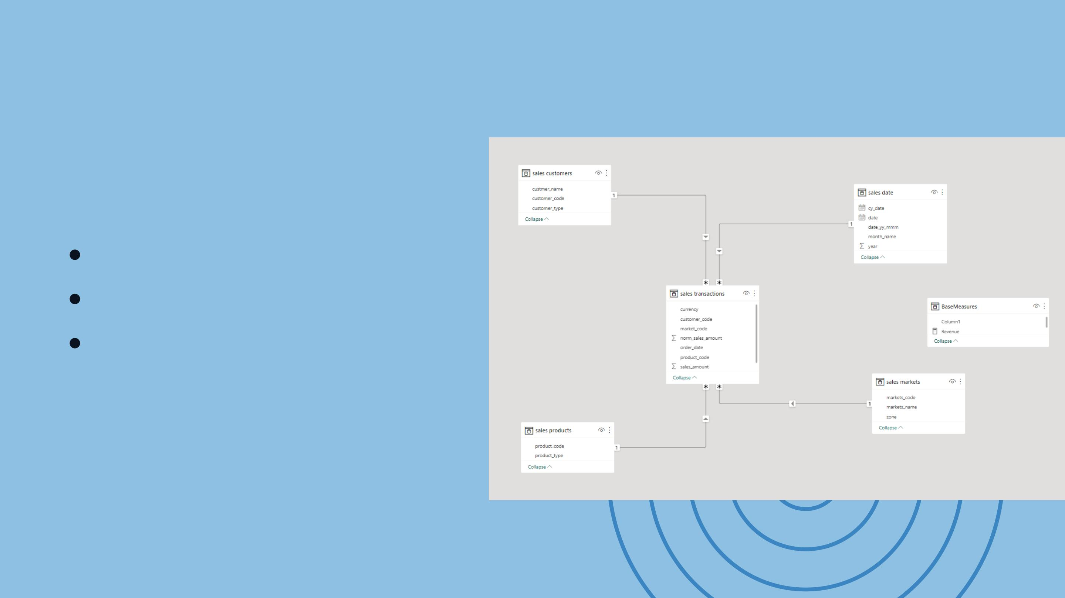
APPROACH
DATA MODELLING
CREATING MEASURES
DATA VISUALISATION AND
GETTING INSIGHTS

Slide 6
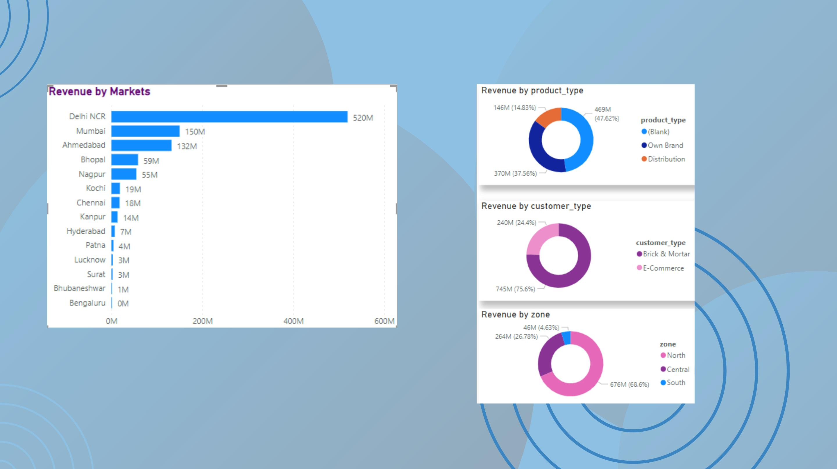
RESULTS-REVENUE INSIGHTS
It seems like Delhi is giving the company the
most revenue. I guess the company in the
other markets are really being the bargain
basement of employers. Maybe they are
shopping for a luxury car in the bargain
bin section
It can be concluded that around 65-
70% revenue is generated by the North
Zone

Slide 7
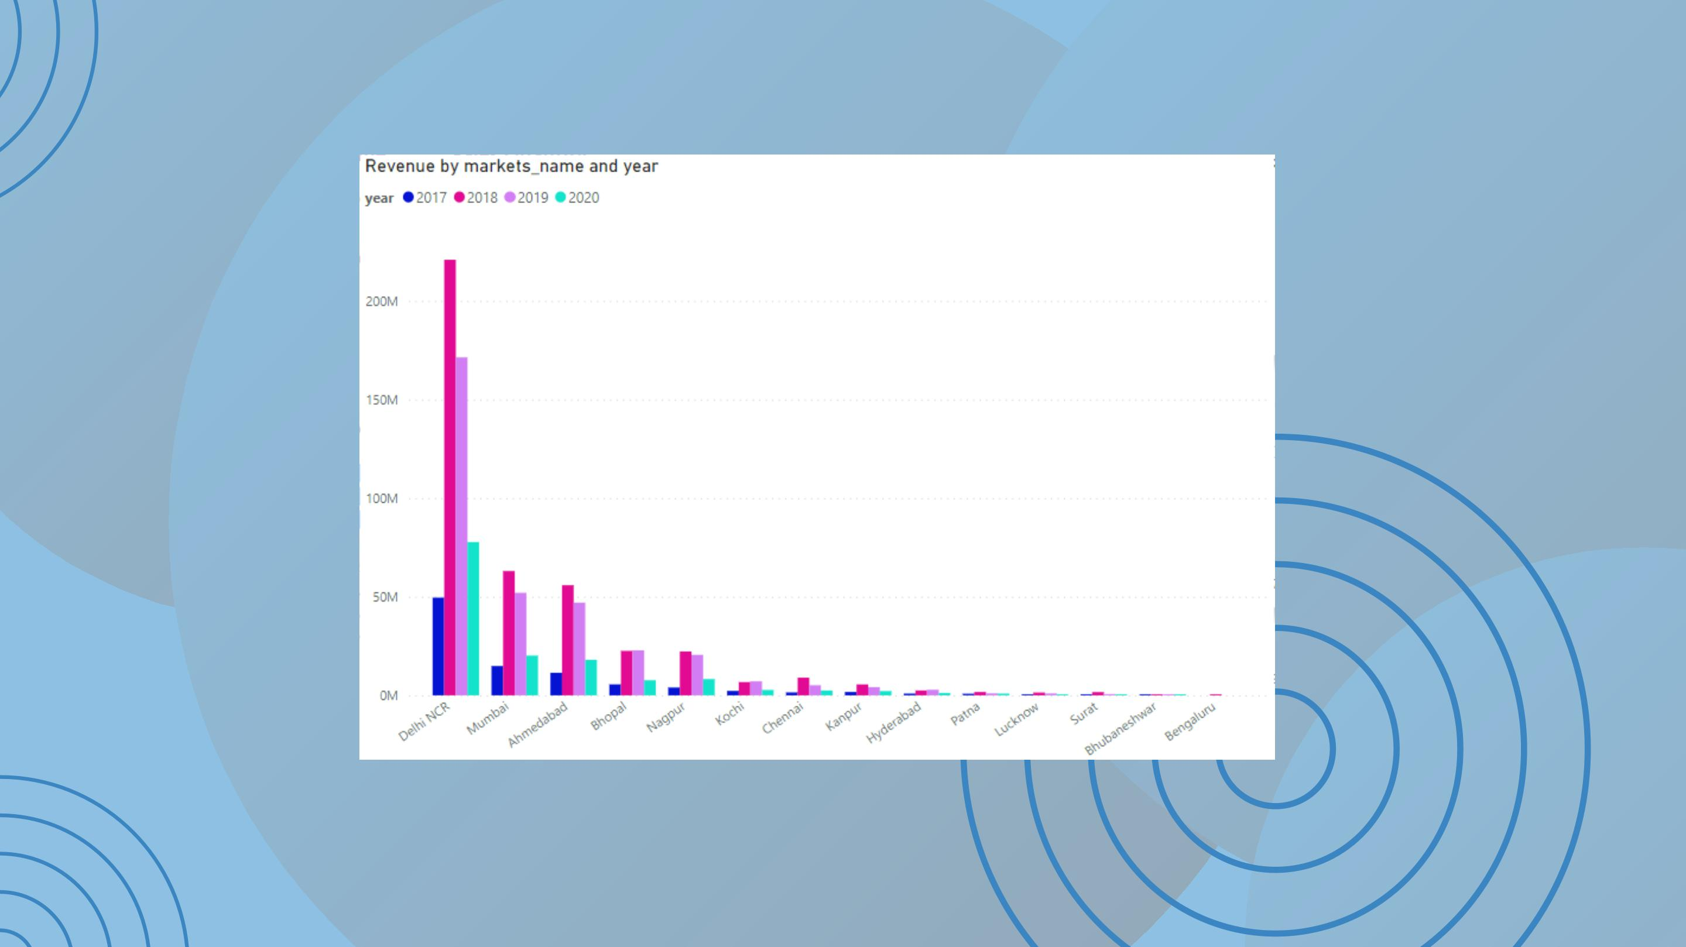
RESULTS- CITY INSIGHTS
From the trend , we can infer that Delhi NCR
generated the most revenue in 2018 in comparison
to all other markets in any other year

Slide 8
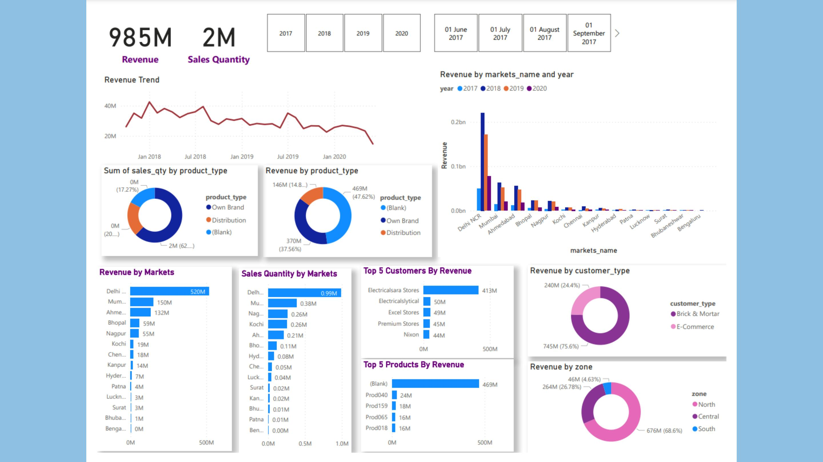

Slide 9

RECOMMENDATIONS
The selling price of products can be increased for
customers where its low such as 'Premium stores' as
this company was in top 2 wrt total sales quantity but
in top 4 wrt revenue, which infers that company is
selling products to Premium stores in much lesser
proce than other customers
Analyse the trend why the fall in revenue is
happening in corresponding years.

Slide 10

THANK
YOU

